Slide 1

Airbnb Price Prediction City of Boston
Group 6 - Final Group Project
August 2021

Slide 2

Team Members
Syed Ahmed
Pascal Duchesneau
Raissa Fondjo
Geetha Shanthibushan
Lalchand Shivraj

Slide 3

Overview
Estimating a price for short time stay lodging is a difficult task.
Customers select rental based on price, review, and picture of the property, but the property may not live up to its listing.
Therefore, our team decided to develop a price prediction model using machine learning.

Slide 4
Objective
Build a model that predicts the ideal price of a property taking into account listing features.
Presentation
Data Exploration & Analysis
Database
Machine Learning
Dashboard

Slide 5






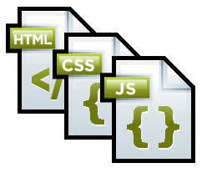



What we used
Dataset
Database
Language
Tools
Technologies
Algorithms
Linear Regression
Decision Tree
Random Forest
Deep Learning

Slide 6

Data Exploration The ETL Process
Extract
Extract clean data from sources, ensuring it has all necessary information and limited null values
Transform
Transform data, removing null values and unnecessary columns, joining datasets, creating separate data frames, and creating look-up tables
Load
Load the data by writing it into Postgres using the confirmed look-up tables to allow multiple users to access

Slide 7

Preliminary Data Analysis
What are the key factors that affect the price of the rental property?
Which neighborhoods in Boston have the highest rental prices?
Within the same neighborhood what make a customer selecting one property vs another?
Room Type
Property Type
Number of Reviews
Amenities
Neighborhoods are separated into 25 districts.
Neighborhood with fewer listings have higher average listing price and neighborhood with higher listings has lower average price
Identify if there is a correlation between count of Listing, Avg. Review Scores Rating and Avg. Price for each Neighborhood.

Slide 8
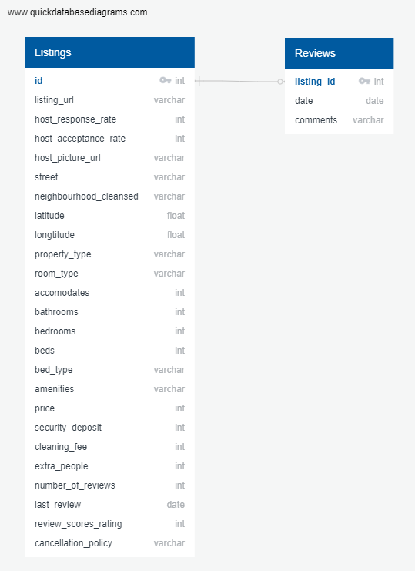

Database
Used postgres by way of pgAdmin as our database to house the tables of data.
Hosted as raw datasets to access the data for multiple users.

Slide 9

Machine Learning

Slide 10
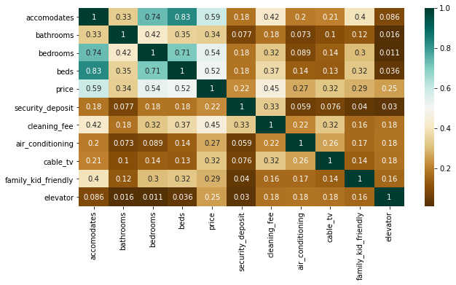
Heatmap: Features Correlation
Exploratory Analysis:
X variables included the features shown in the correlation matrix above, and our 'y' variable was price.

Slide 11
Split of Train & Test Data
Statistical Modeling Methodology
Train Data
70%
Test Data
30%
Regression Models
Random Forest Regressor
Linear Regression
Decision Tree Regression

Slide 12
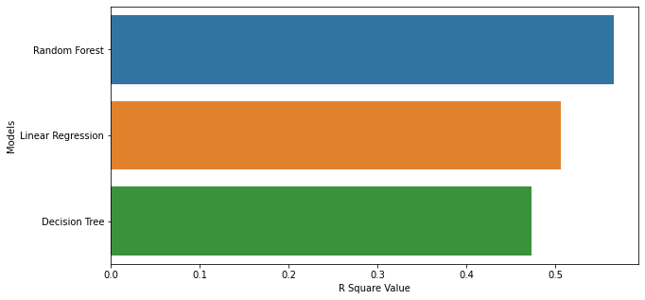
R Square Value
Regression Models:

Slide 13
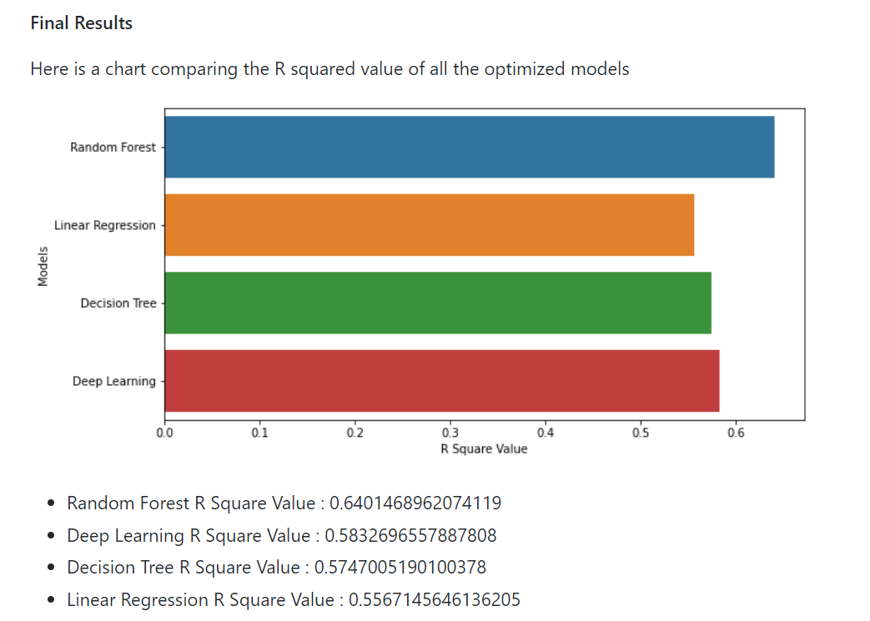
Model Optimization
Statistical Modeling Methodology
Train Data
67%
Test Data
33%
Final Results

Slide 14

Dashboard
For the dashboard segment of this project, we will be using:
The Visual Analysis: Tableau
The Website: GitHub
The Interactive Elements: Heroku

Slide 15
Conclusion
To boost R squared scores for each model:
Reselected appropriate features from the dataset,
Changed the train test split to 67%, 33%
removed outliers that were present in the target variable.
Added a Deep Learning model.

Slide 16
Conclusion
Recommendation for future analysis
•Explore more models to improve fit such as a Recurrent Neural Net with data put in time stamps to be able to make future predictions.
What we would have done differently
•Explore more data sources to find more factors that could influence rental price

